Slide 1


Social Network Mining
Final Report
Chen Liguo Shao Yanjun Shao Yi

Slide 2
Contents
Intro
Graph Analysis
Link Prediction
Community Detection
Node Classification

Slide 3
Contents
Intro
Graph Analysis
Link Prediction
Community Detection
Node Classification

Slide 4
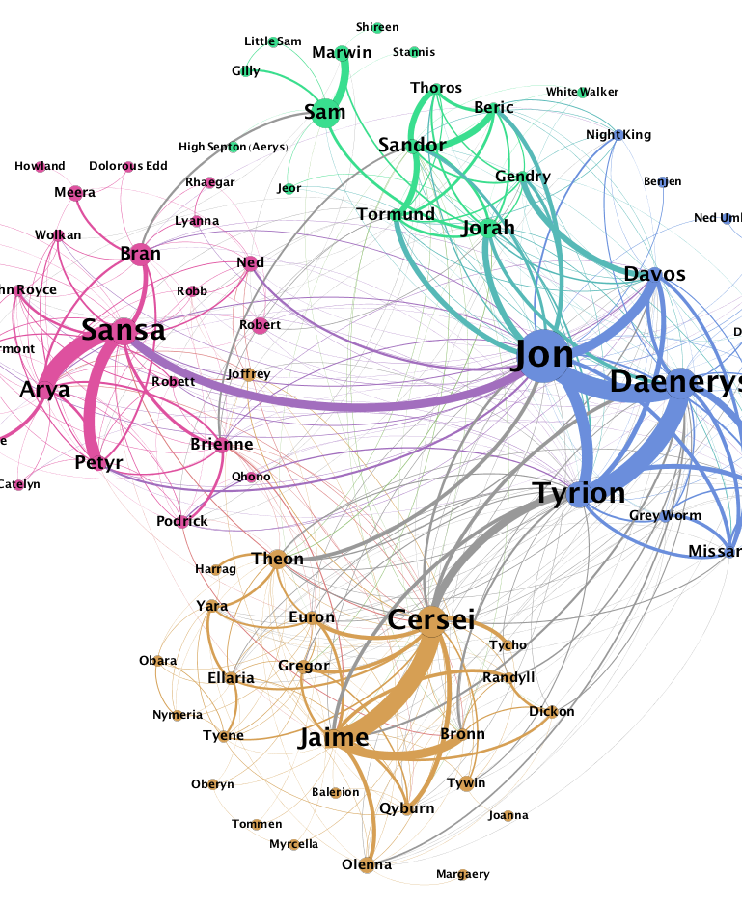
PART I
Intro

Slide 5
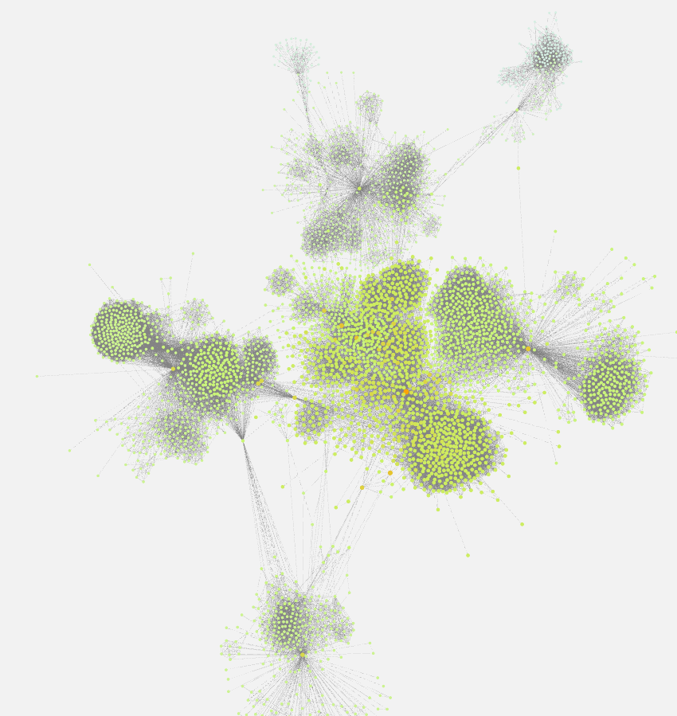
Dataset statistics
Nodes | 4039
Edges | 88234
Number of triangles | 1612010
Fraction of closed triangles | 0.2647
Diameter (longest shortest path) | 8
Average cost | 3.6925
Ego-Facebook Dataset
This dataset consists of 'circles' (or 'friends lists') from Facebook. Facebook data was collected from survey participants using this Facebook app. The dataset includes node features (profiles), circles, and ego networks.

Slide 6
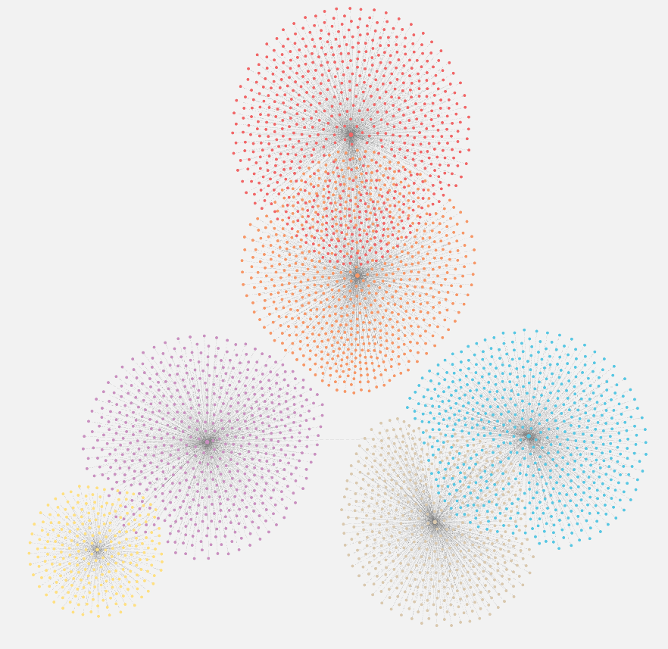
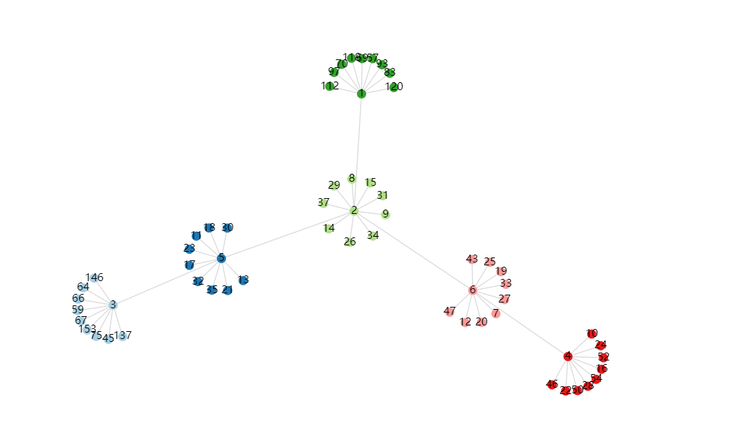
Citeseer Dataset
This dataset consists of 3312 scientific publications classified into one of six classes. The citation network consists of 4732 links. Each publication in the dataset is described by a 0/1-valued word vector indicating the absence/presence of the corresponding word from the dictionary. The dictionary consists of 3703 unique words.
Dataset statistics
Nodes | 3312
Edges | 4732
Number of triangles | 0
Fraction of closed triangles | 0
Diameter (longest shortest path) | 6
Average cost | 3.6541

Slide 7
PART II
Community
Detection

Slide 8
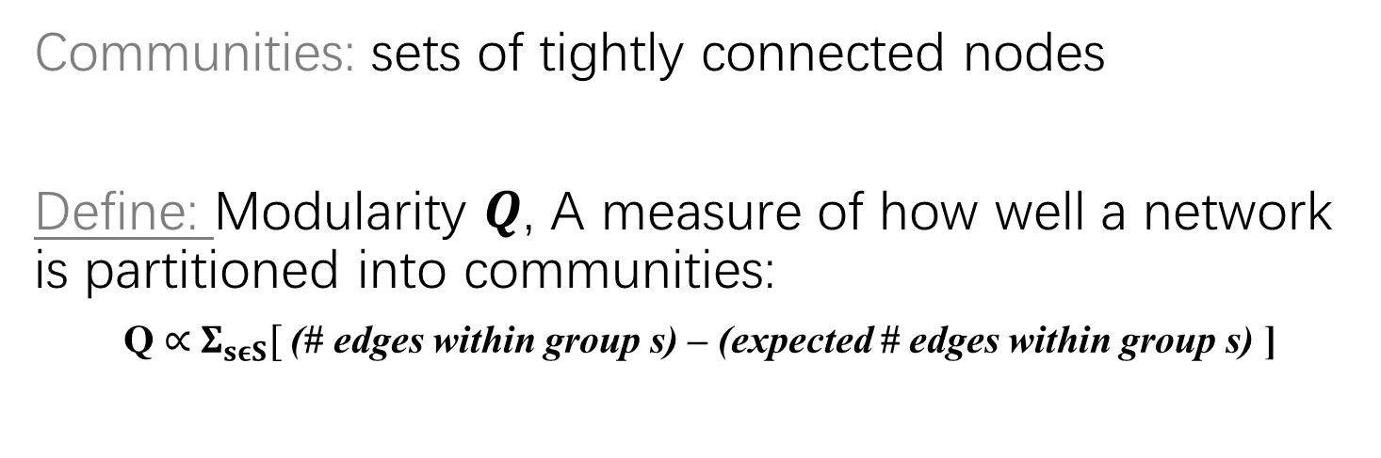
Community Detection
Communities: sets of tightly connected nodes
Define: Modularity 𝑸, A measure of how well a network is partitioned into communities:
Q $∝$ $Σ_{sεS}[$ (# edges within group s) – (expected # edges within group s) ]

Slide 9
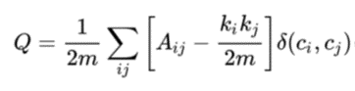
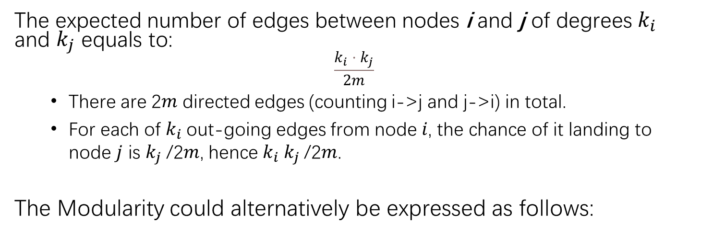
Community Detection
The expected number of edges between nodes i and j of degrees $k_{i}$ and $k_{j}$ equals to:
$$\frac{k_{i}⋅k_{j}}{2m}$$
There are 2𝑚 directed edges (counting i->j and j->i) in total.
For each of $k_{i}$out-going edges from node 𝑖, the chance of it landing to node 𝑗 is $k_{j}$/2𝑚, hence $k_{i} k_{j}$/2𝑚.
The Modularity could alternatively be expressed as follows:

Slide 10
Louvain Algorithm
Louvain algorithm greedily maximizes modularity
Each pass is made of 2 phases:
Phase 1: Modularity is optimized by allowing only local changes to node-communities membership
Δ𝑄(𝐷 → 𝑖 → 𝐶) = Δ𝑄(𝐷 → 𝑖) + Δ𝑄(𝑖 → C)
𝐶 = argmax(Δ𝑄(D → 𝑖 → 𝐶))
D ← D − {𝑖}
𝐶 ← 𝐶 + {𝑖}
Phase 2: The identified communities are aggregated into super-nodes to build a new network
Super nodes are constructed by merging nodes in the same community.
Goto Phase 1

Slide 11
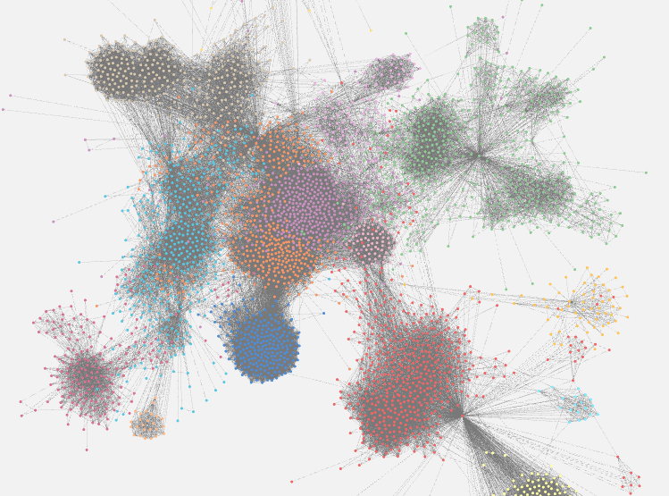
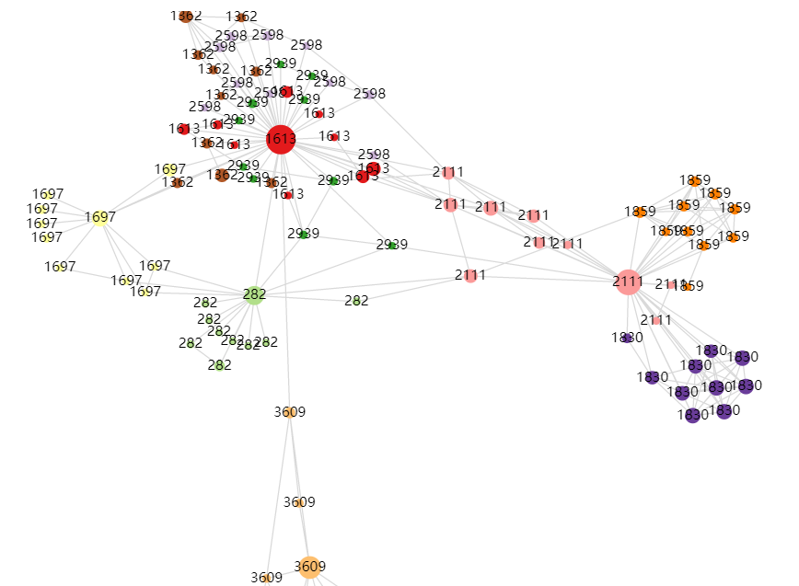
Louvain Algorithm
On Ego-Facebook

Slide 12
PART III
Graph Analysis

Slide 13
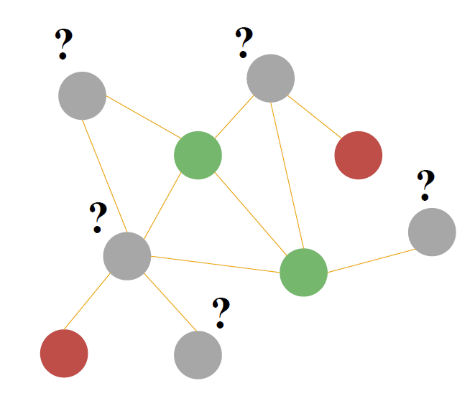
Node-level Algorithms
Node degree
Node centrality
Eigenvector centrality
PageRank centrality
Betweenness centrality
Closeness centrality

Slide 14
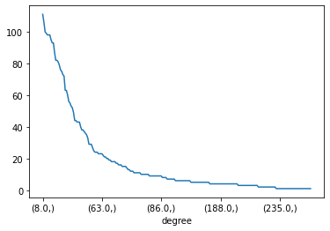
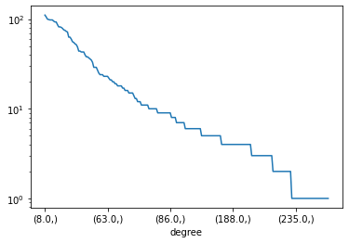
Degree Distribution

Slide 15
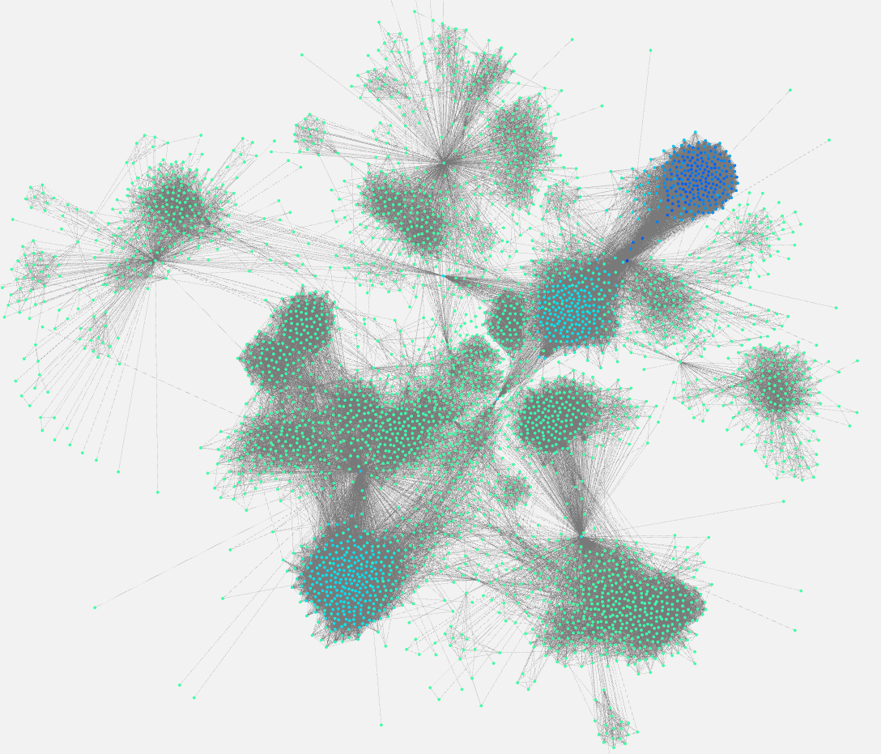
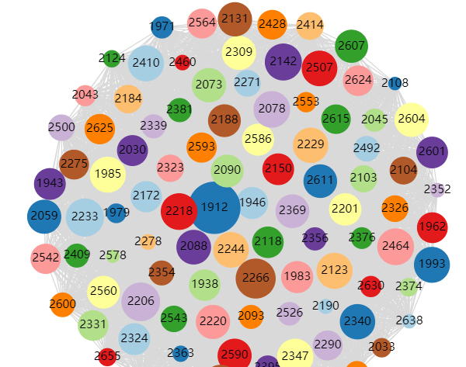


Eigenvector Centrality
We model the centrality of node 𝑣 as the sum of the centrality of neighboring nodes:
$$c_{v}=\frac{1}{λ}\sum_{uεN}{c_{u}}$$
$$λc=Ac$$

Slide 16
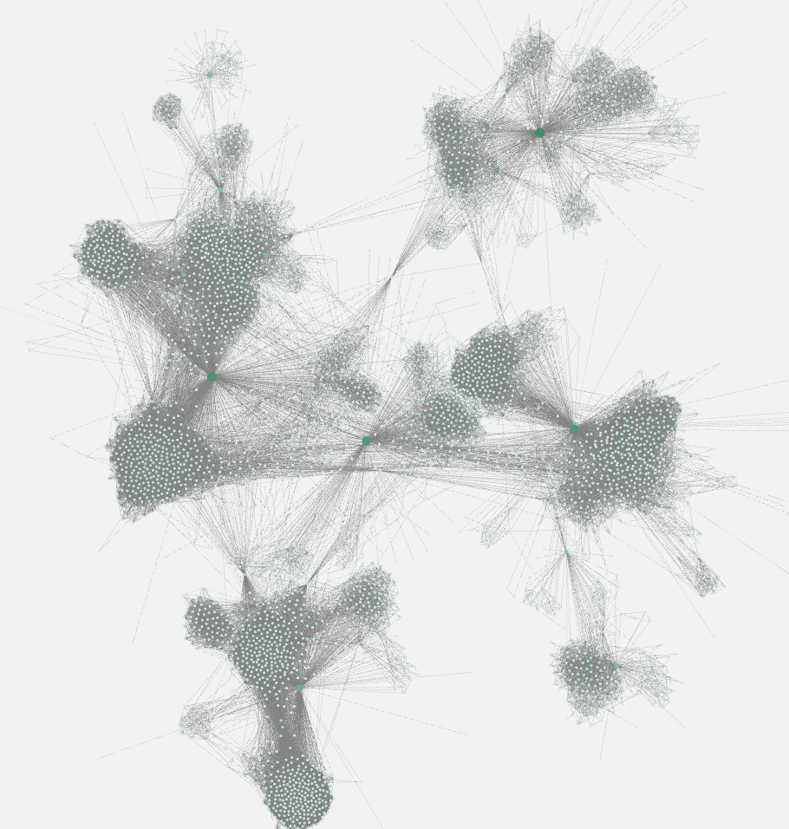
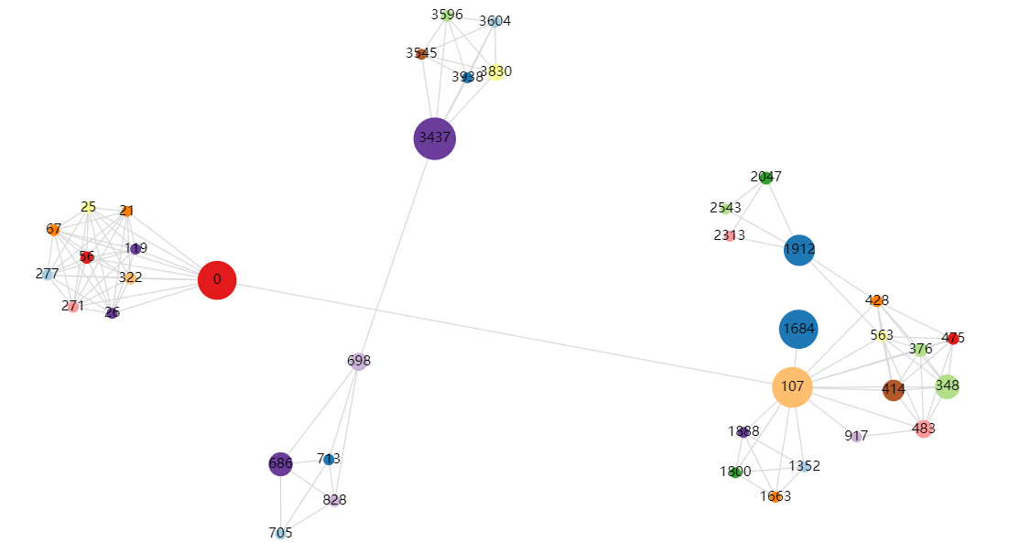


PageRank Centrality
We model the centrality of node 𝑣 as the sum of the centrality of neighboring nodes in a more explainable way:
$$C_{p}\left(v\right)=β+α\sum_{j=1}{A_{j,i}\frac{C_{p}\left(v_{j}\right)}{d_{j}^{out}}}$$
$$C_{p}=β{\left(I−αA^{T}D^{−1}\right)}^{−1}⋅1$$

Slide 17
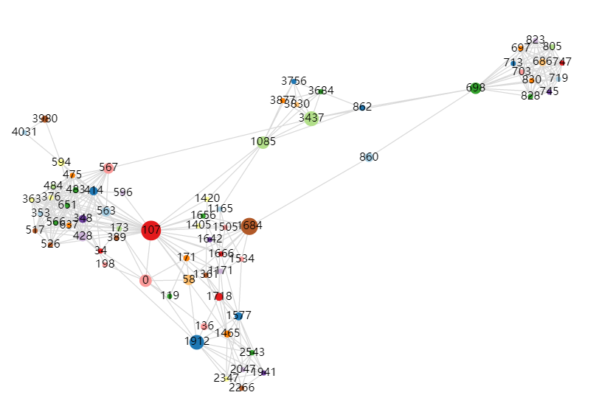
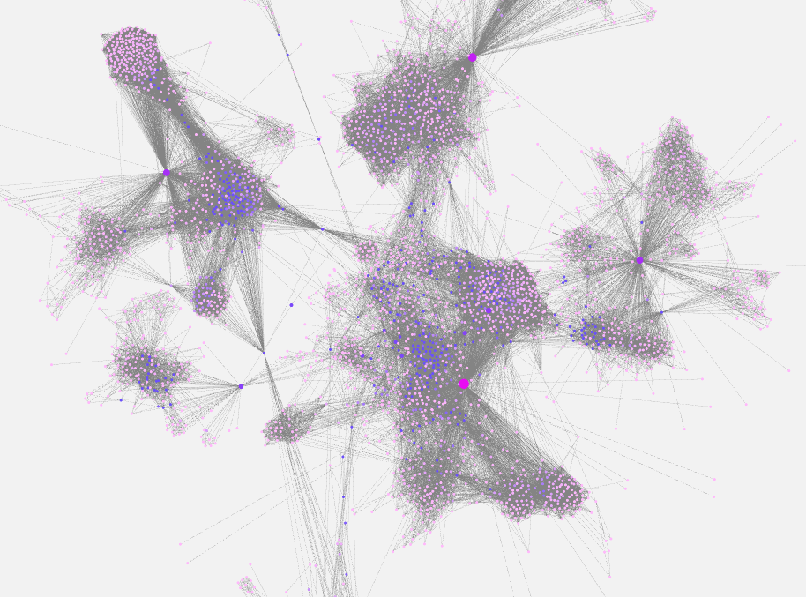

Betweenness Centrality
A node is important if it lies on many shortest paths between other nodes:
$$c_{v}=\sum_{s≠v≠t}{\frac{\#(shortest paths between s and t that contain v)}{\#(shortest paths between s and t)}}$$

Slide 18
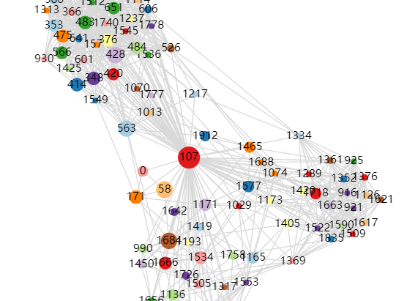

Closeness Centrality
A node is important if it has small shortest pathlengths to all other nodes:
$$c_{v}=\frac{1}{\sum_{u≠v}{shortest path length between u and v}}$$

Slide 19
Total Stats
id | eigenvector
1912 | 296.5844
2266 | 254.0166
2206 | 250.4103
2233 | 248.8579
2142 | 245.7742
2464 | 245.2242
2218 | 244.9369
2078 | 244.8809
2347 | 243.8131
2123 | 243.4639
id | degree
107 | 1045
1684 | 792
1912 | 755
3437 | 547
0 | 347
2543 | 294
2347 | 291
1888 | 254
1800 | 245
1663 | 235
id | pagerank
3437 | 29.67998
107 | 27.08421
1684 | 24.78503
0 | 24.49815
1912 | 15.06055
348 | 9.13446
686 | 8.667531
3980 | 8.451854
414 | 7.026296
698 | 5.099148
id | betweenness
107 | 3916560
1684 | 2753287
3437 | 1924506
1912 | 1868918
1085 | 1214578
0 | 1192496
698 | 940024.2
567 | 784996.9
58 | 687595
428 | 524164.1
id | closeness
107 | 0.459699
58 | 0.397402
428 | 0.394837
563 | 0.393913
1684 | 0.393606
171 | 0.370493
348 | 0.369916
483 | 0.369848
414 | 0.369543
376 | 0.366558

Slide 20
PART IV
Link
Prediction

Slide 21
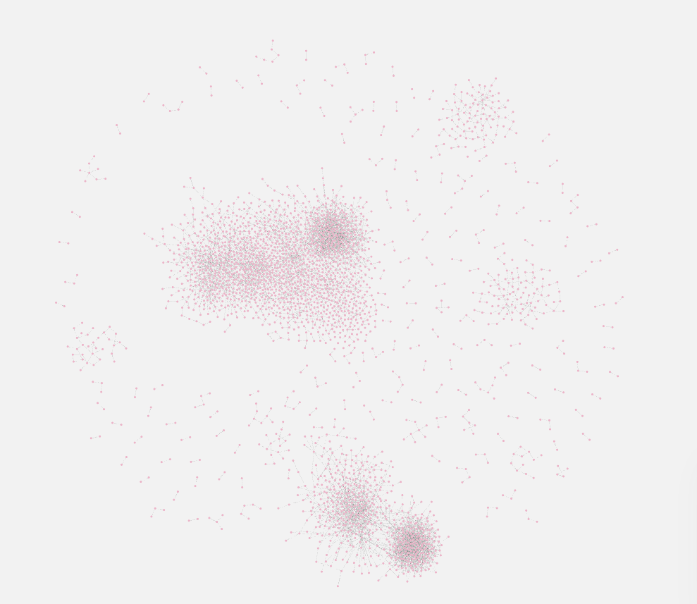
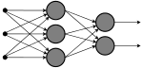
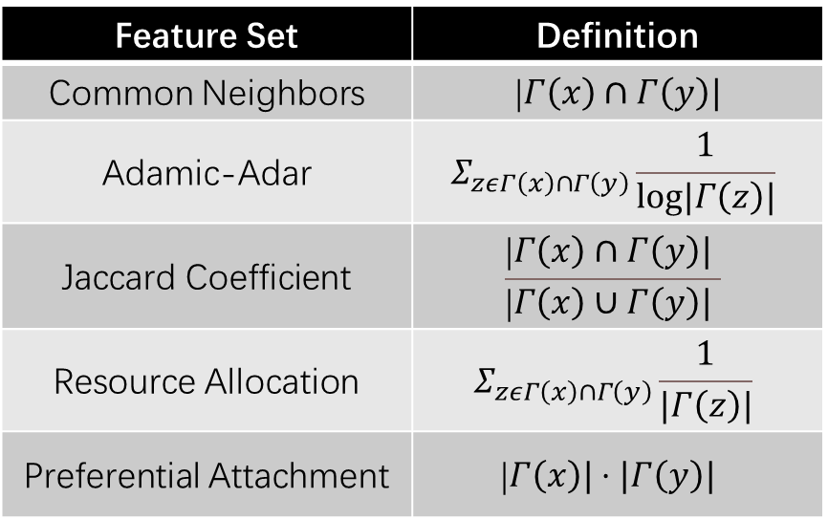
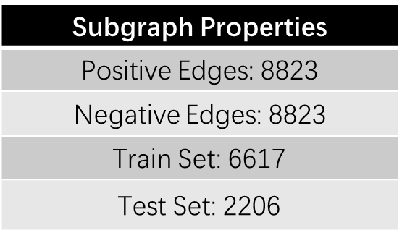
Naïve Predictor
Feature Set | Definition
Common Neighbors | |$Γ\left(x\right)∩Γ\left(y\right)|$
Adamic-Adar | $$Σ_{zεΓ\left(x\right)∩Γ\left(y\right)}\frac{1}{log|Γ\left(z\right)|}$$
Jaccard Coefficient | $$\frac{\text{|}Γ\left(x\right)∩Γ\left(y\right)| }{\text{|}Γ\left(x\right)∪Γ\left(y\right)| }$$
Resource Allocation | $$Σ_{zεΓ\left(x\right)∩Γ\left(y\right)}\frac{1}{|Γ\left(z\right)|}$$
Preferential Attachment | $$\text{|}Γ\left(x\right)|⋅|Γ\left(y\right)|$$
Subgraph Properties
Positive Edges: 8823
Negative Edges: $\text{882}\text{3}$
Train Set: 6617
Test Set: 2206
Method | Accuracy
SVM | 0.679111
Logistic | 0.665357
MLP | 0.680623

Slide 22
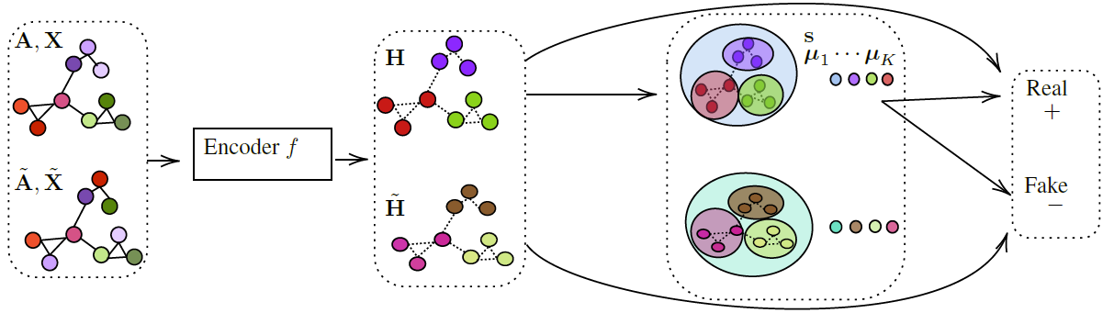
GIC ( Graph InfoClust )
Dataset: Citeseer
- Significantly more structure that can be captured
- Additionally capture cluster-level information content
- Clusters are computed by a differentiable K-means method
Result:
- alpha, beta, K = 0.5 100 128
- AUC = 0.97 AP = 0.97

Slide 23
PART V
Node Classification

Slide 24
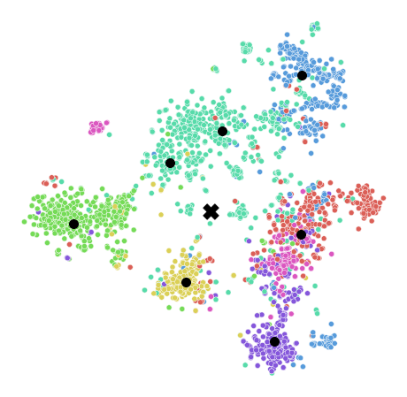
GIC ( Graph InfoClust )
Dataset: Cora (Citeseer missing labels)
Result:
alpha, beta, K = 0.5 100 7
num_classes = 7
Acc = 0.73

Slide 25
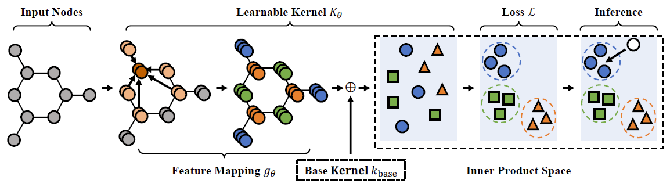
Kernel GCN
Dataset: Cora
Motivated by graph kernel methodology
Extended to learn the node representations capturing the structural information in a graph
Flexible and complementary to other graph-baseddeep learning models, e.g. GCN
Result:
- Loss = 0.6543
- Accuracy = 0.8010

Slide 26
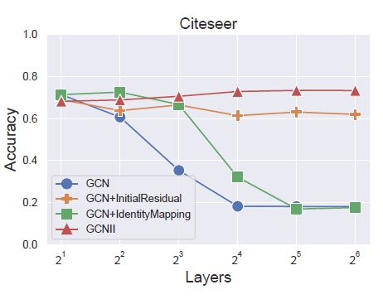
GCNII ( Graph Convolutional Network via Initial residual and Identity mapping )
Dataset: Cora
Initial residual connection
Identity mapping
Connection to iterative shrinkage-thresholding
Result:
- Load 1063th(/1164) epoch
- Test acc. = 85.4 %

Slide 27
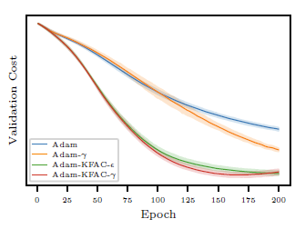
SSP ( Optimization of Graph Neural Networks with Natural Gradient Descent )
Dataset: Cora
Using an estimation of the inverse of the Fisher information matrix
For faster calculation it is preferred to use an approximation of Fisher like Kronecker-Factored Approximate Curvature (KFAC)
Result:
- GCN-Cora2-Adam-KFAC-eps0.1
- Val Loss = 0.4454, Test Accuracy = 87.09 ± 0.35

Slide 28
References:
CS244W http://web.stanford.edu/class/cs224w/
Optimization of Graph Neural Networks with Natural Gradient Descent, arXiv:2008.09624 [cs.LG]
Graph InfoClust: Leveraging cluster-level node information for unsupervised graph representation learning, arXiv:2009.06946 [cs.LG]
Rethinking Kernel Methods for Node Representation Learning on Graphs, arXiv:1910.02548 [cs.LG]
Simple and Deep Graph Convolutional Networks, arXiv:2007.02133 [cs.LG]

Slide 29
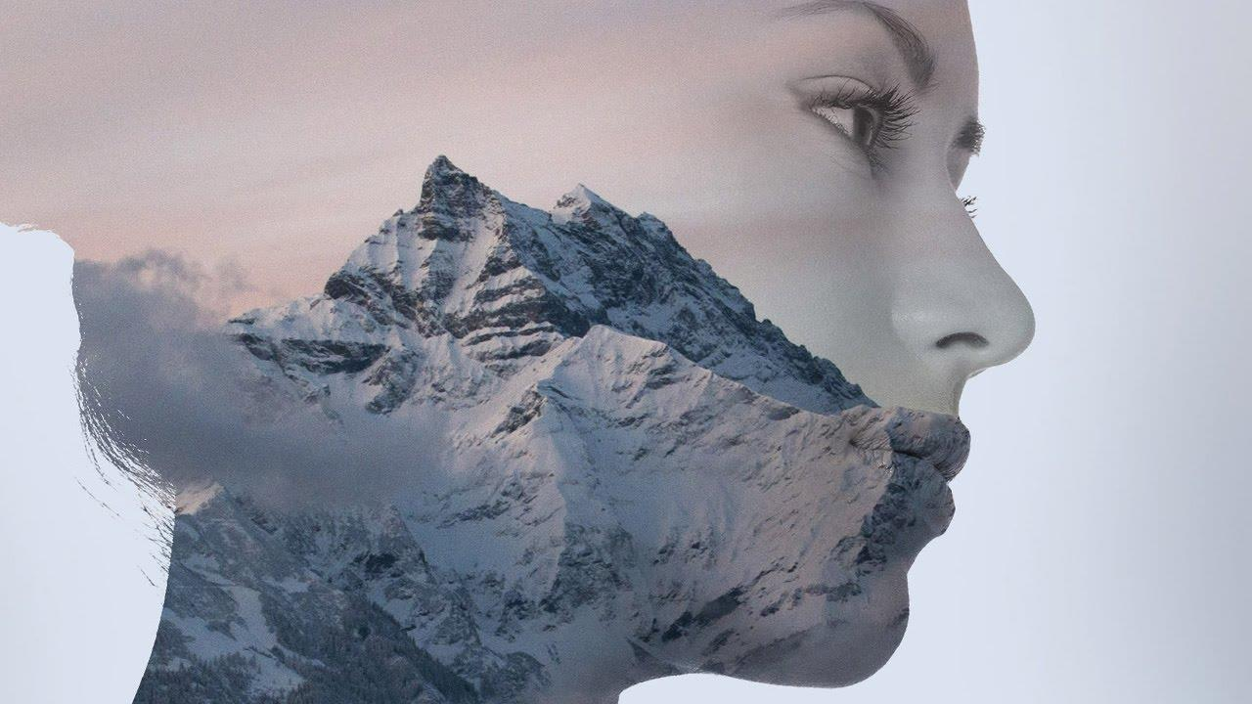
Thank You

